Slide 1
BigData and MapReduce I
Kit318/418

Slide 2
Assignment 2 Marking Scheme (Note Changes)
Matrix Multiplication (10%)
Implementing 2 Data partitioning techniques (3+3 Marks)
1.5 Marks for each implementation will be given if code only works for matrix size in multiple of num of processors (ie. Matrix Size=p*N where p is an integer and N is number of processors)
Report: Algorithm description(justification of approach) and Performance evaluation (4 Marks)
Algorithm Description carries 1 Marks
Performance evaluation
On local machine (personal computers) [1 Mark]
On Nectar Cloud (2 Marks)
Evaluation using different flavor of machines for different sizes of matrix with number of 4 processes.
M2-tiny, m2.xsmall, m2.small, m2.medium, m1.small, m1.medium

Slide 3


Slide 4

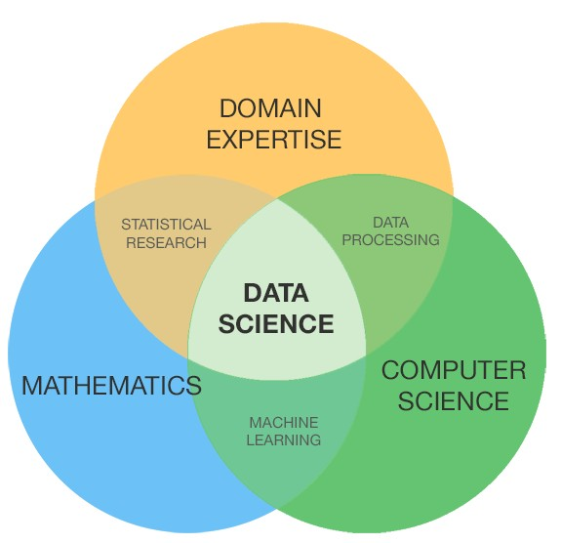
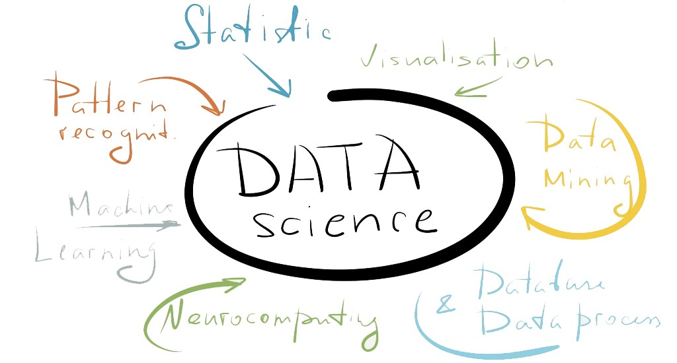
Data Science
New approach to do science
Step 1: Collect data
Step 2: Generate Hypotheses
Step 3: Validate Hypotheses
Step4: (Goto Step 1 or 2)
Why is this a good approach?
Automated: no thinking, less error
Why is this a bad approach?
How to debug without a ground truth?
More generally, interdisciplinary emerging field (see images)

Slide 5
Modern Data Scientists
Computer Engineer
collect and integrate disparate data sources
Develop applications and manage Big Data and large scale computing
Mathematician
machine learning
statistics
Artist
visualise data beautifully
tell a convincing story

Slide 6
Big Data Characteristics
Too Many Bytes
Too high data rates
Volume
Velocity
Too many sources
Too Noisy
Variety
Variety
10

Slide 7
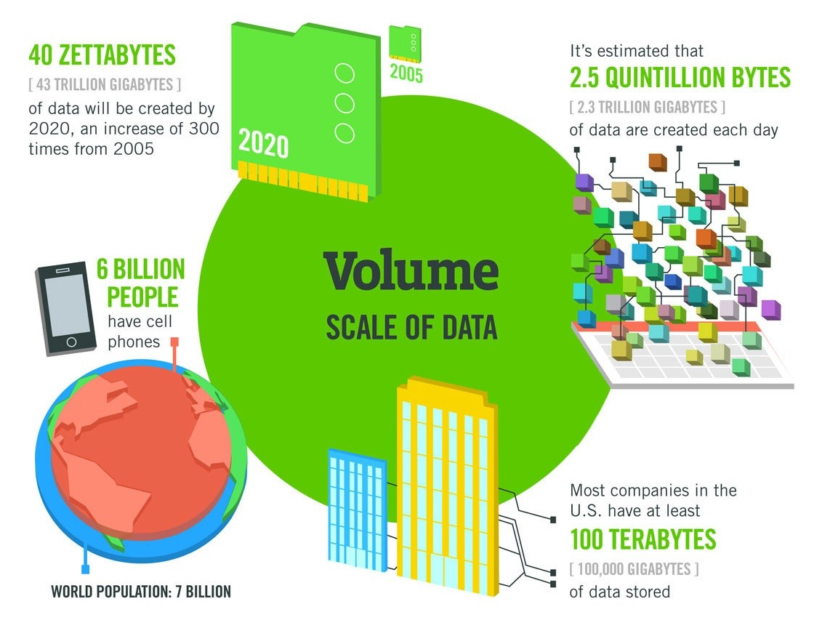
11

Slide 8
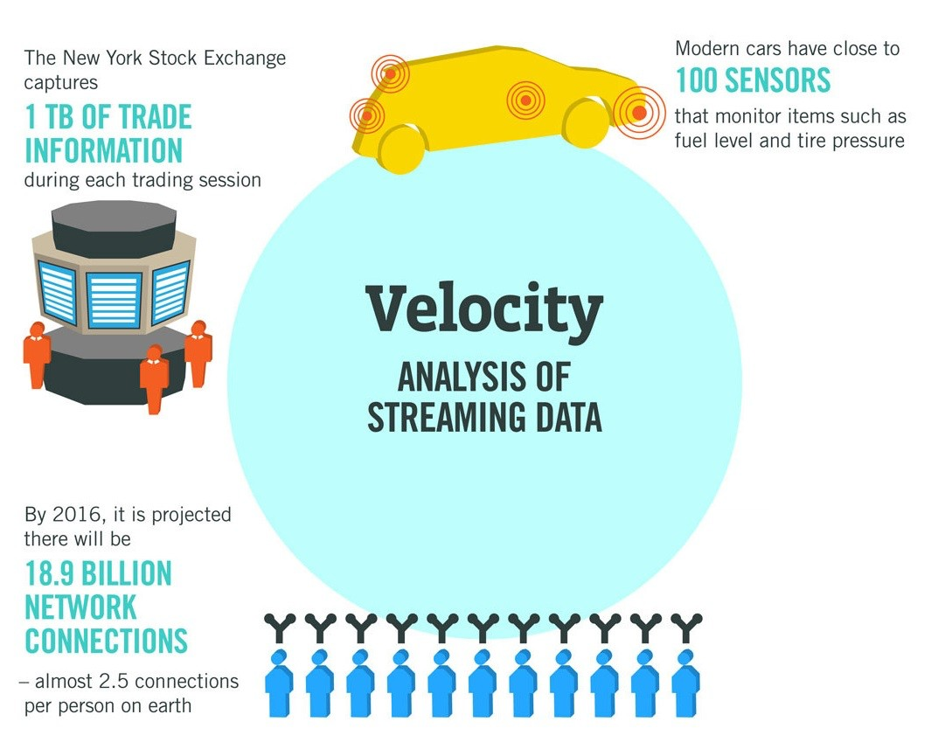
12

Slide 9
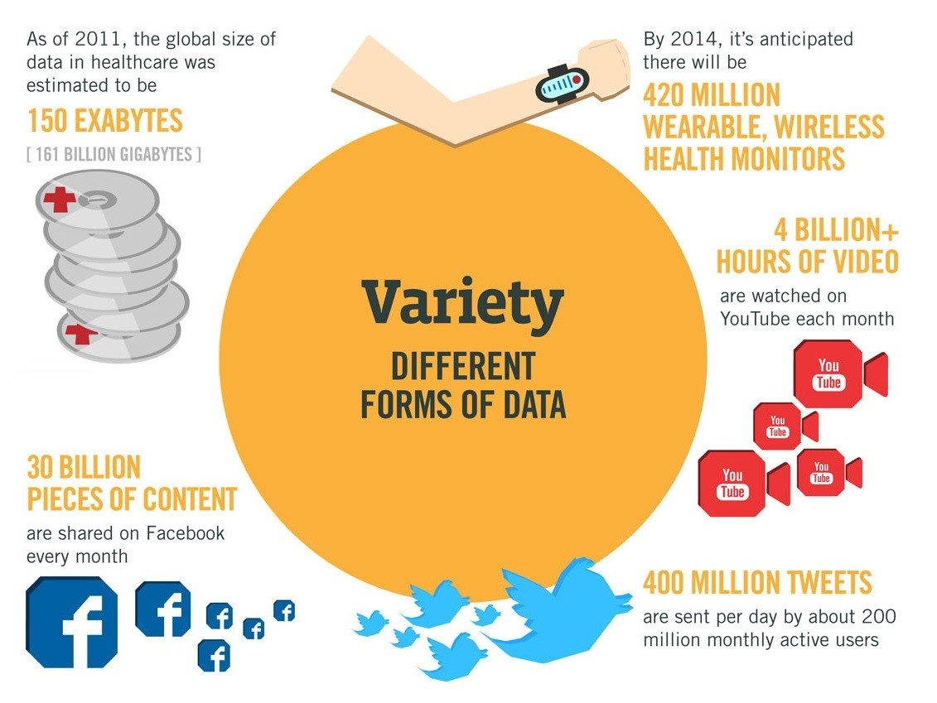
13

Slide 10
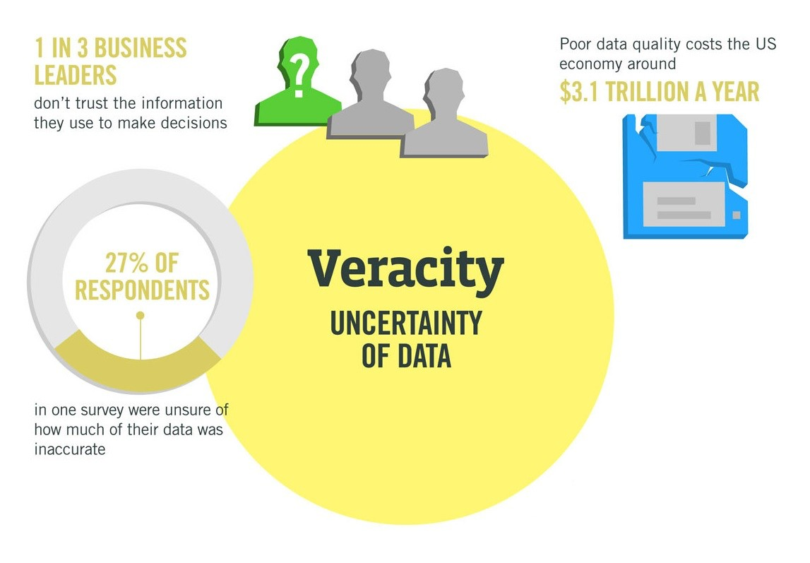
14

Slide 11


Big Data – Business perspective
New Business Model
People pay with data, e.g. Facebook, Google, Twitter:
use service, give data
Google sells your data to advertisers
you pay advertisers indirectly
23andMe, Amazon:
pay service + give data
sells data and
uses data to improve service

Slide 12
Big Data – Technical perspective
You collect all data
the more the better -> statistical relevance,
keeping all is cheaper than deciding what to keep
You decide independently what to do with data
run experiments on data when question arises
Huge difference to traditional information systems
Design upfront what data to keep and why!!!

Slide 13
“Big” data - Pros & Cons
Pros
tolerate errors
discover the long tail and corner cases – machine learning works much better
Cons
More data, more error (e.g., semantic heterogeneity)
With enough data you can prove anything
still need humans to ask right questions

Slide 14

Big Data Success Story
Google Translate
You collect snippets of translations
You match sentences to snippets
You continuously debug your system
Why does it work?
There are tons of snippets on the Web
There is a ground truth that helps to debug system
Google Translate is based on something called "statistical machine translation". This means that they gather as much text as they can find that seems to be parallel betweentwo languages, and then they crunch their data to find the likelihood that something in Language A corresponds to something in Language B. This method works to some extent for language pairs where a lot of more-or-less parallel data is available, for example English-Spanish. […] (quora.com)

Slide 15
Big Data Companies
Climate Corporation
14 TB of historical weather data
All computation done on Amazon EC2
GNIP
Aggregates several TB of new social data per day
Stored using Amazon S3

Slide 16
New Big Data Technologies
Infrastructure:
New computing/programming paradigms: Cloud,Map/ Reduce
New storage solutions: NoSQL, column stores, Big Table
New languages: JAQL, Pig Latin
New Platforms: Spark, Hadoop, Storm
Analysis and Mining:
New infrastructure demands new approaches to explore data
We will study algorithms to process and analyze data in Big-Data environments

Slide 17
Map Reduce

Slide 18
Motivation: Google Example
20+ billion web pages x 20KB = 400+ TB
1 computer reads 30-35 MB/sec from disk
~4 months to read the web
~1,000 hard drives to store the web
Takes even more to do something useful with the data!
Today, a standard architecture for such problems is:
Cluster of commodity Linux nodes
Commodity network (ethernet) to connect them

Slide 19
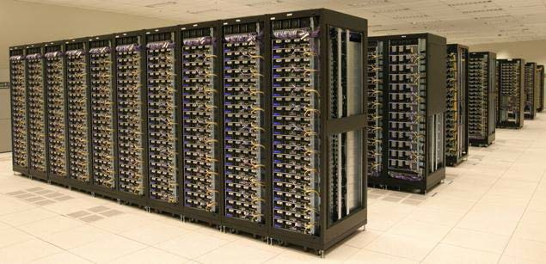
Cluster Architecture
2-10 Gbps backbone between racks
1 Gbps between
any pair of nodes
in a rack
Switch
Switch
Switch
CPU
CPU
CPU
CPU
Mem
…
Mem
Mem
…
Mem
Disk
Disk
Disk
Disk
Each rack contains 16-64 nodes
In 2011 it was estimated that Google had 1Million machines.

Slide 20
Large-scale BigData Computing
Large-scale computing for Big Data problems on commodity hardware
Challenges:
How do you distribute computation and data?
How can we make it easy to write distributed programs?
Machines fail:
One server may stay up 3 years (1,000 days)
If you have 1,000 servers, expect to loose 1/day
People estimated Google had ~1M machines in 2011
1,000 machines fail every day!

Slide 21
Idea and Solution
Issue: Copying data over a network takes time
Idea:
Bring computation close to the data
Store files multiple times for reliability
Map-reduce addresses these problems
Google’s computational/data manipulation model
Elegant way to work with big data
Storage Infrastructure – File system
Google: GFS. Hadoop: HDFS
Programming model
Map-Reduce

Slide 22
Storage Infrastructure
Problem:
If nodes fail, how to store data persistently?
Answer:
Distributed File System:
Provides global file namespace
Google GFS; Hadoop HDFS;
Typical usage pattern
Huge files (100s of GB to TB)
Data is rarely updated in place
Reads and appends are common

Slide 23
Distributed File System
Chunk servers
File is split into contiguous chunks
Typically each chunk is 16-64MB
Each chunk replicated (usually 2x or 3x)
Try to keep replicas in different racks
Master node
a.k.a. Name Node in Hadoop’s HDFS
Stores metadata about where files are stored
Might be replicated
Client library for file access
Talks to master to find chunk servers
Connects directly to chunk servers to access data

Slide 24
Distributed File System
Reliable distributed file system
Data kept in “chunks” spread across machines
Each chunk replicated on different machines
Seamless recovery from disk or machine failure
C₀
C₁
D₀
C₁
C₂
C₅
C₀
C₅
…
C₅
Chunk server 1
C₂
C₅
Chunk server 2
C₃
D₀
Chunk server 3
D₁
D₀
Chunk server N
C₂
Bring computation directly to the data!
Chunk servers also serve as compute servers
Notes:
24

Slide 25
MapReduce & Hadoop: Historical Background
2003: Google publishes about its cluster architecture & distributed file system
2004: Google publishes about its MapReduce programming model
2006: Apache & Yahoo! -> Hadoop & HDFS
open-source, Java implementations of Google MapReduce and GFS with a diverse set of APIs available to public
evolved from Apache Lucene/Nutch open-source web search engine (Nutch MapReduce and NDFS)
2008: Hadoop becomes an independent Apache project
Today: Hadoop is used as a general-purpose storage and analysis platform for big data
other Hadoop distributions from several vendors including EMC, IBM, Microsoft, Oracle, Cloudera, etc.
many users (http://wiki.apache.org/hadoop/PoweredBy)
research and development actively continues
Adapted from Slides by Donald Kossmann & Nesime Tatbul

Slide 26
MapReduce in a Nutshell
Given:
a very large dataset
a well-defined computation task to be performed on elements of this dataset (preferably, in a parallel fashion on a large cluster)
MapReduce framework:
Just express what you want to compute (map() & reduce()).
Don’t worry about parallelization, fault tolerance, data distribution, load balancing (MapReduce takes care of these).
What changes from one application to another is the actual computation; the programming structure stays similar.
Adapted from Slides by Donald Kossmann & Nesime Tatbul

Slide 27
MapReduce in a Nutshell
Here is the framework in simple terms:
Read lots of data.
Map: extract something that you care about from each record.
Shuffle and sort.
Reduce: aggregate, summarize, filter, or transform.
Write the results.
One can use as many Maps and Reduces as needed to model a given problem.
Adapted from Slides by Donald Kossmann & Nesime Tatbul

Slide 28
MapReduce vs. Traditional RDBMS
 | MapReduce | Traditional RDBMS
Datasize | Petabytes | Gigabytes
Access | Batch | Interactive and batch
Updates | Write once, read many times | Read and write many times
Structure | Dynamic schema | Static schema
Integrity | Low | High (normalized data)
Scaling | Linear | Non-linear (general SQL)
Adapted from Slides by Donald Kossmann & Nesime Tatbul

Slide 29
MapReduce Basic Programming Model
Transform a set of input key-value pairs to a set of output values:
Map: (k1, v1) → list(k2, v2)
MapReduce library groups all intermediate pairs with same key together.
Reduce: (k2, list(v2)) → list(v2)
Adapted from Slides by Donald Kossmann & Nesime Tatbul

Slide 30
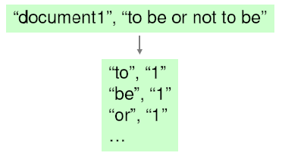
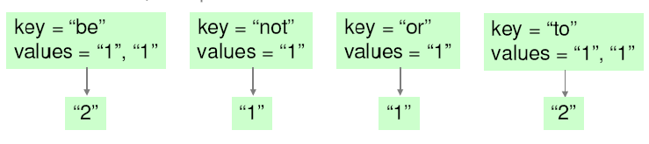
MapReduce Canonical Example Count word occurrences in a set of documents
map(k1, v1) → list(k2, v2) reduce(k2, list(v2)) → list(v2)
map (String key, String value):
// key: document name
// value: document contents for each word w in value:
EmitIntermediate(w, "1");
reduce (String key, Iterator values):
// key: a word
// values: a list of counts int result = 0;
for each v in values: result += ParseInt(v);
Emit(AsString(result));
Adapted from Slides by Donald Kossmann & Nesime Tatbul

Slide 31
MapReduce Parallelization
Multiple map() functions run in parallel, creating different intermediate values from different input data sets.
Multiple reduce() functions also run in parallel, each working on a different output key.
All values are processed independently.
Bottleneck: The reduce phase can’t start until the map phase is completely finished.
Adapted from Slides by Donald Kossmann & Nesime Tatbul

Slide 32
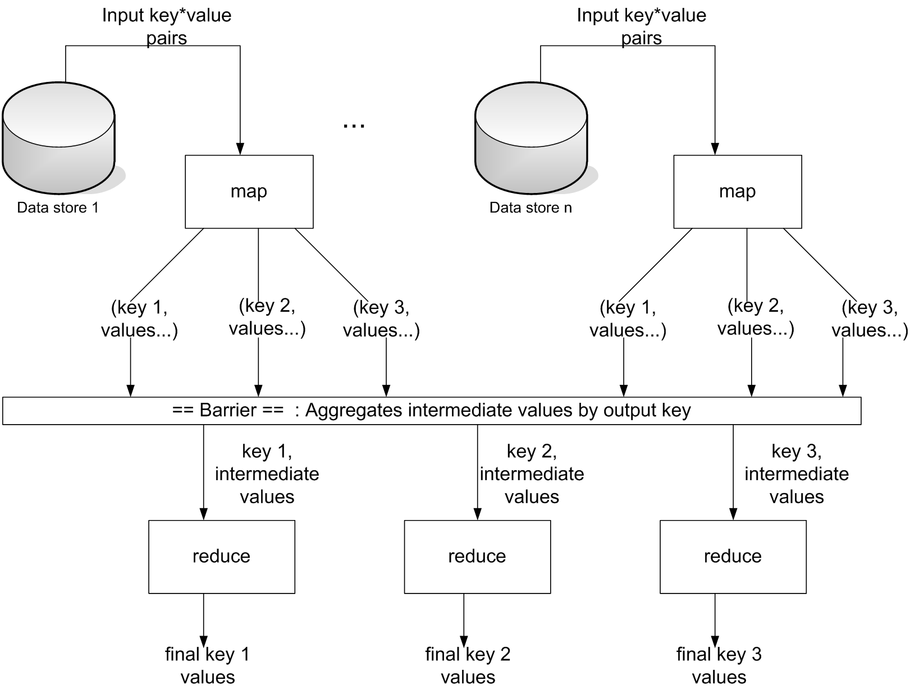
MapReduce Parallel Processing Model
Adapted from Slides by Donald Kossmann & Nesime Tatbul

Slide 33
Map-Reduce: Environment
Map-Reduce environment takes care of:
Partitioning the input data
Scheduling the program’s execution across a set of machines
Performing the group by key step
Handling machine failures
Managing required inter-machine communication

Slide 34
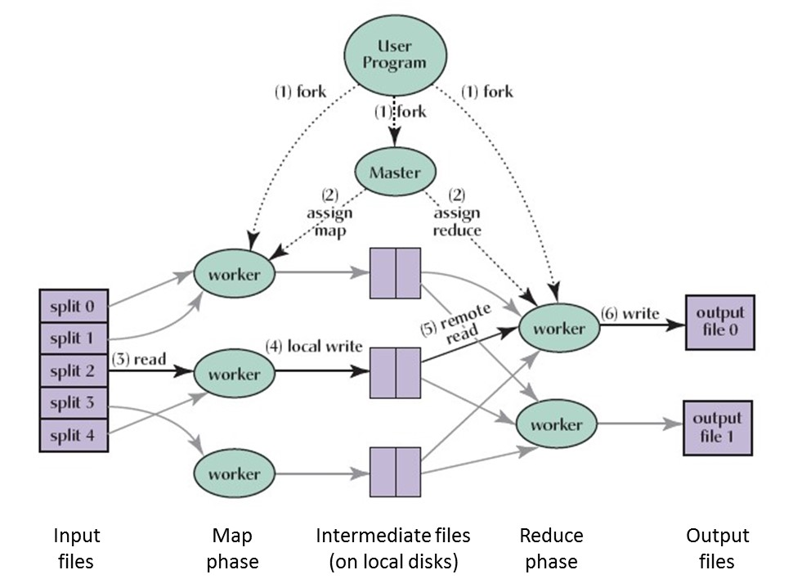
MapReduce Execution Overview
Adapted from Slides by Donald Kossmann & Nesime Tatbul

Slide 35
MapReduce Scheduling
One master, many workers
Input data split into M map tasks (typically 64 MB (~ chunk size in GFS))
Reduce phase partitioned into R reduce tasks (hash(k) mod R)
Tasks are assigned to workers dynamically
Master assigns each map task to a free worker
Considers locality of data to worker when assigning a task
Worker reads task input (often from local disk)
Worker produces R local files containing intermediate k/v pairs
Master assigns each reduce task to a free worker
Worker reads intermediate k/v pairs from map workers
Worker sorts & applies user’s reduce operation to produce the output
Adapted from Slides by Donald Kossmann & Nesime Tatbul

Slide 36
How to Choose M and R?
M = number of map tasks, R = number of reduce tasks
Larger M, R: creates smaller tasks, enabling easier load balancing and faster recovery (many small tasks from failed machine)
Limitation: O(M+R) scheduling decisions and O(M*R) in-memory state at master
Very small tasks not worth the startup cost
Recommendation:
Choose M so that split size is approximately 64 MB
Choose R a small multiple of the number of workers; alternatively choose R a little smaller than #workers to finish reduce phase in one “wave”
Adapted from Slides by Donald Kossmann & Nesime Tatbul

Slide 37
MapReduce Fault Tolerance
On worker failure:
Master detects failure via periodic heartbeats.
Both completed and in-progress map tasks on that worker should be re-executed (→ output stored on local disk).
Only in-progress reduce tasks on that worker should be re-executed (→ output stored in global file system).
All reduce workers will be notified about any map re-executions.
On master failure:
State is check-pointed to GFS: new master recovers & continues.
Robustness:
Example: Lost 1600 of 1800 machines once, but finished fine.
Adapted from Slides by Donald Kossmann & Nesime Tatbul

Slide 38
MapReduce Data Locality
Goal: To conserve network bandwidth.
In GFS, data files are divided into 64 MB blocks and 3 copies of each are stored on different machines.
Master program schedules map() tasks based on the location of these replicas:
–Put map() tasks physically on the same machine as one of the input replicas (or, at least on the same rack / network switch).
This way, thousands of machines can read input at local disk speed. Otherwise, rack switches would limit read rate.
30
Adapted from Slides by Donald Kossmann & Nesime Tatbul

Slide 39
Stragglers & Backup Tasks
Problem: “Stragglers” (i.e., slow workers) significantly lengthen the completion time.
Solution: Close to completion, spawn backup copies of the remaining in-progress task
Whichever one finishes first, “wins”.
Additional cost: a few percent more resource usage.
Example: A sort program without backup = 44% longer.
Adapted from Slides by Donald Kossmann & Nesime Tatbul

Slide 40
Other Practical Extensions
User-specified combiner functions for partial combination within a map task can save network bandwidth (~ mini-reduce)
Example: Word Count?
User-specified partitioning functions for mapping intermediate key values to reduce workers (by default: hash(key) mod R)
Example: hash(Hostname(urlkey)) mod R
Ordering guarantees: Processing intermediate k/v pairs in increasing order
Example: reduce of Word Count outputs ordered results.
Custom input and output format handlers
Single-machine execution option for testing & debugging
Adapted from Slides by Donald Kossmann & Nesime Tatbul

Slide 41
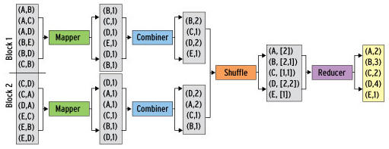
Example: Combiners
Back to our word counting example:
Combiner combines the values of all keys of a single mapper (single machine):
Much less data needs to be copied and shuffled!

Slide 42
Hadoop
Adapted from Slides by Donald Kossmann & Nesime Tatbul

Slide 43

What is Hadoop?
Hadoop is an ecosystem of tools for MapReduce programming
Hadoop is an open source project.

Slide 44
The Hadoop Family
MapReduce | Distributed computation framework (data processing model and execution environment)
HDFS | Distributed file system
HBase | Distributed, column-oriented database
Hive | Distributed data warehouse
Pig | Higher-level data flow language and parallel execution framework
ZooKeeper | Distributed coordination service
Avro | Data serialization system (RPC and persistent data storage)
Sqoop | Tool for bulk data transfer between structured data stores (e.g., RDBMS) and HDFS
Oozie | Complex job workflow service
Chukwa | System for collecting management data
Mahout | Machine learning and data mining library
BigTop | Packaging and testing ₃₆

Slide 45
Hadoop: Architectural Design Principles
Linear scalability
More nodes can do more work within the same time
Linear on data size, linear on compute resources
Move computation to data
Minimize expensive data transfers
Data is large, programs are small
Reliability and Availability: Failures are common
Simple computational model (MapReduce)
Hides complexity in efficient execution framework
Streaming data access (avoid random reads)
More efficient than seek-based data access

Slide 46





Hadoop Main Cluster Components
HDFS daemons
NameNode: namespace and block management (~ master in GFS)
DataNodes: block replica container (~ chunkserver in GFS)
MapReduce daemons
JobTracker: client communication, job scheduling, resource management, lifecycle coordination (~ master in Google MR)
TaskTrackers: task execution module (~ worker in Google MR)
NameNode
JobTracker
TaskTracker
TaskTracker
TaskTracker
DataNode
DataNode
DataNode

Slide 47
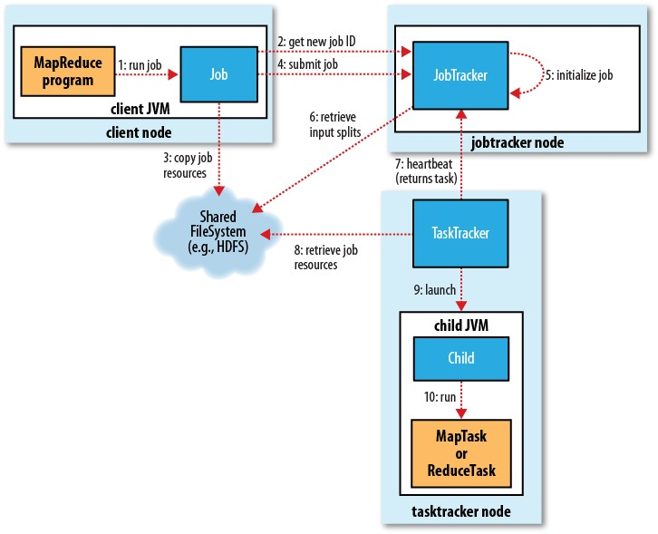
MapReduce Job Execution in Hadoop
40

Slide 48
Job Submission (1-4)
Client submits MapReduce job through Job.submit() call
Job submission process
Get new job ID from JobTracker
Determine input splits for job
Copy job resources (job JAR file, configuration file, computed input splits) to HDFS into directory named after the job ID
Inform JobTracker that job is ready for execution

Slide 49
Job Initialization (5-6)
JobTracker puts ready job into internal queue
Job scheduler picks job from queue
Initializes it by creating job object
Creates list of tasks
One map task for each input split
Number of reduce tasks determined by mapred.reduce.tasks property in Job, which is set by setNumReduceTasks()
Tasks need to be assigned to worker nodes

Slide 50
Task Assignment (7)
TaskTrackers send heartbeats to JobTracker
Indicate if ready to run new tasks
Number of “slots” for tasks depends on number of cores and memory size
JobTracker replies with new task
Chooses task from first job in priority-queue
Chooses map tasks before reduce tasks
Chooses map task whose input split location is closest to machine running the TaskTracker instance (data-local < rack- local < off-rack; data locality optimization)
Could also use other scheduling policy

Slide 51
Task Execution (8-10)
TaskTracker copies job JAR and other configuration data from HDFS to local disk
Creates local working directory
Creates TaskRunner instance
TaskRunner launches new JVM (or reuses one from another task) to execute the JAR

Slide 52
Monitoring Job Progress
Tasks report progress to TaskTracker
TaskTracker includes task progress in heartbeat message to JobTracker
JobTracker computes global status of job progress
JobClient polls JobTracker regularly for status
Visible on console and web UI

Slide 53
MapReduce Development Steps
Write Map and Reduce functions
Create unit tests
Write driver program to run a job
Can run from IDE with small data subset for testing
If test fails, use IDE for debugging
Update unit tests and Map/Reduce if necessary
Once program works on small test set, run it on full data set
If there are problems, update tests and code accordingly
Fine-tune code, do some profiling

Slide 54
Local (Standalone) Mode
Runs same MapReduce user program as cluster version, but does it sequentially on a single machine
Does not use any of the Hadoop daemons
Works directly with local file system
No HDFS, hence no need to copy data to/from HDFS
Great for development, testing, initial debugging

Slide 55
Pseudo-Distributed Mode
Still runs on a single machine, but simulating a real Hadoop cluster
Simulates multiple nodes
Runs all daemons
Uses HDFS
For more advanced testing and debugging
You can also set this up on your laptop

Slide 56
Programming Language Support
Java API (native)
Hadoop Streaming API
allows writing map and reduce functions in any programming language that can read from standard input and write to standard output
Examples: Ruby, Python
Hadoop Pipes API
allows map and reduce functions written in C++ using sockets to communicate with Hadoop’s TaskTrackers

Slide 57
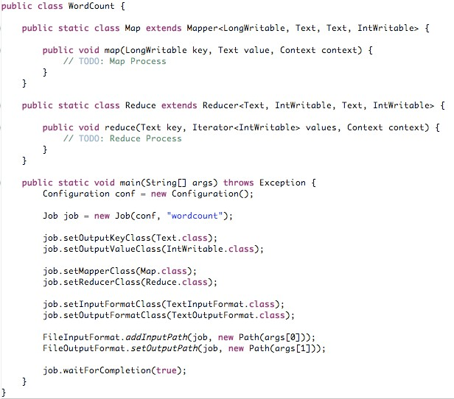




4/10/11
New interface for Hadoop 0.20.*;
job.setJarByClass(WordCount.class)
;
Code from http://wiki.apache.org/hadoop/WordCount

Slide 58
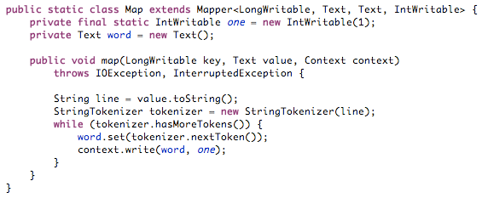
WordCount Map Class

Slide 59
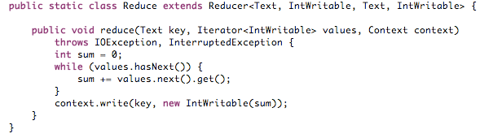
WordCount Reduce Class

Slide 60
Reading
Jeffrey Dean and Sanjay Ghemawat: MapReduce: Simplified Data Processing on Large Clusters
http://labs.google.com/papers/mapreduce.html
Sanjay Ghemawat, Howard Gobioff, and Shun-Tak Leung: The Google File System
http://labs.google.com/papers/gfs.html

Slide 61
Resources
Hadoop Wiki
Introduction
http://wiki.apache.org/lucene-hadoop/
Getting Started
http://wiki.apache.org/lucene-hadoop/GettingStartedWithHadoop
Map/Reduce Overview
http://wiki.apache.org/lucene-hadoop/HadoopMapReduce
http://wiki.apache.org/lucene-hadoop/HadoopMapRedClasses
Eclipse Environment
http://wiki.apache.org/lucene-hadoop/EclipseEnvironment
Javadoc
http://lucene.apache.org/hadoop/docs/api/

